Slide 1
Make Throwable
A VR Carnival Experience
Beta 1.3.3.7

Slide 2
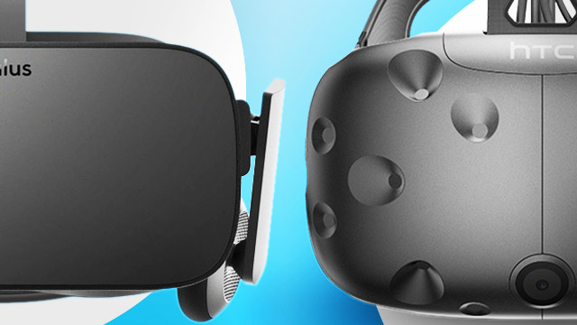
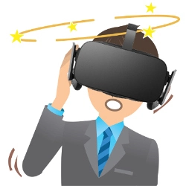
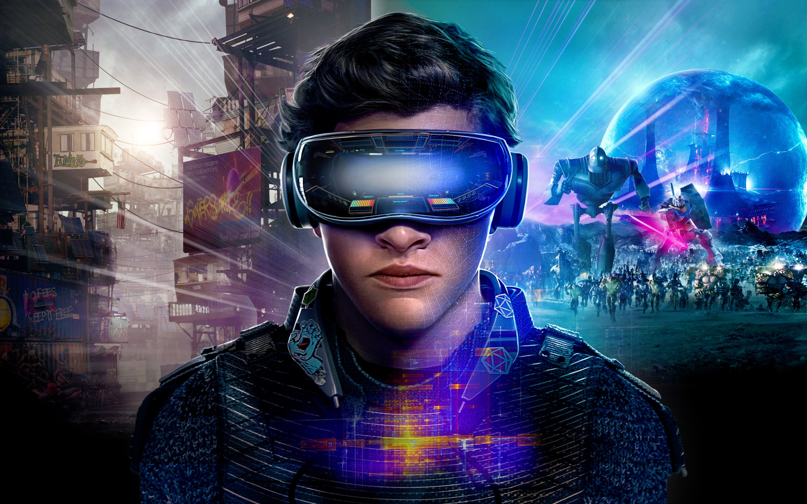
The things we had to think about
Notes:
This is ware we can talk about the diffrent ideas we had starting out for the project. And the things we had to consider. Talk about what makes vr different from other games and other types of development.

Slide 3
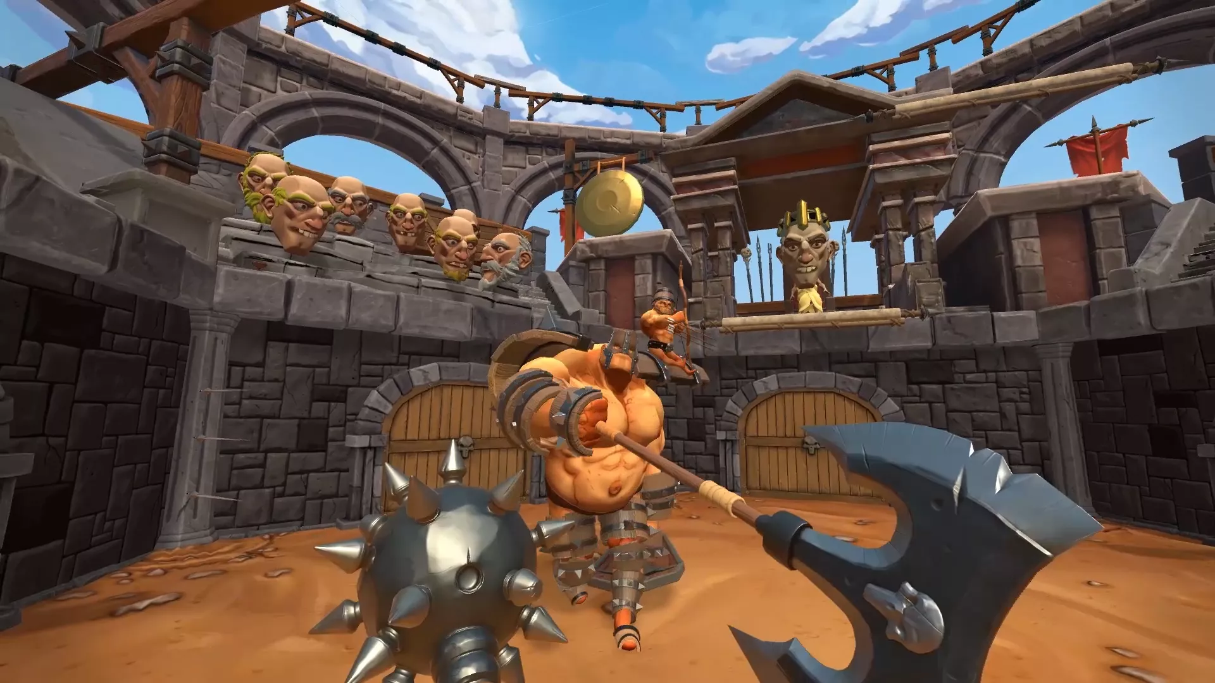
The game ideas we had
Driving sim
Fighting game
VR cup pong
golf

Slide 4
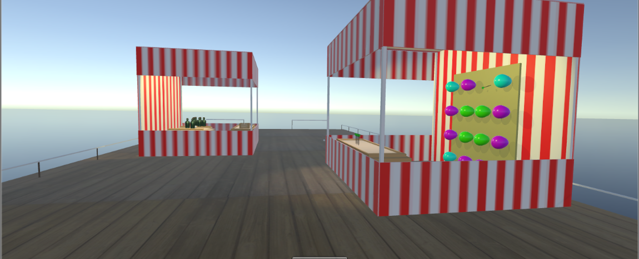
The final Idea

Slide 5
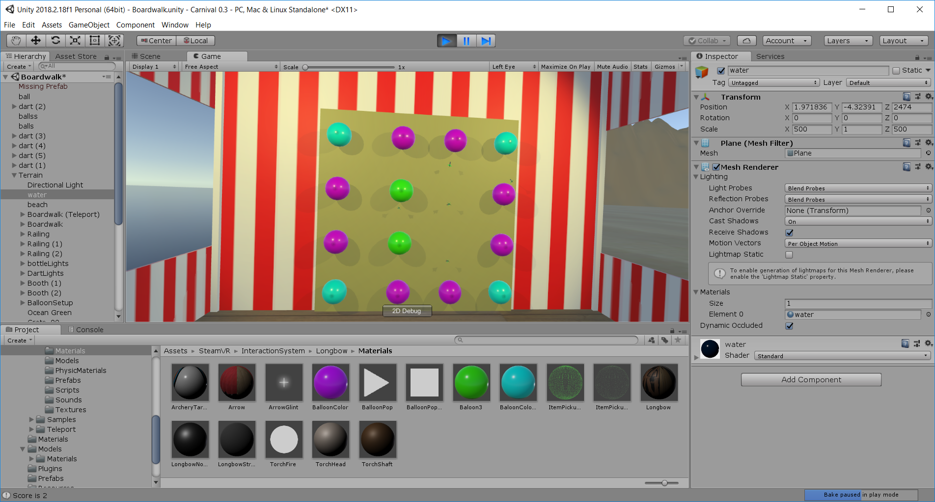
Balloon pop

Slide 6
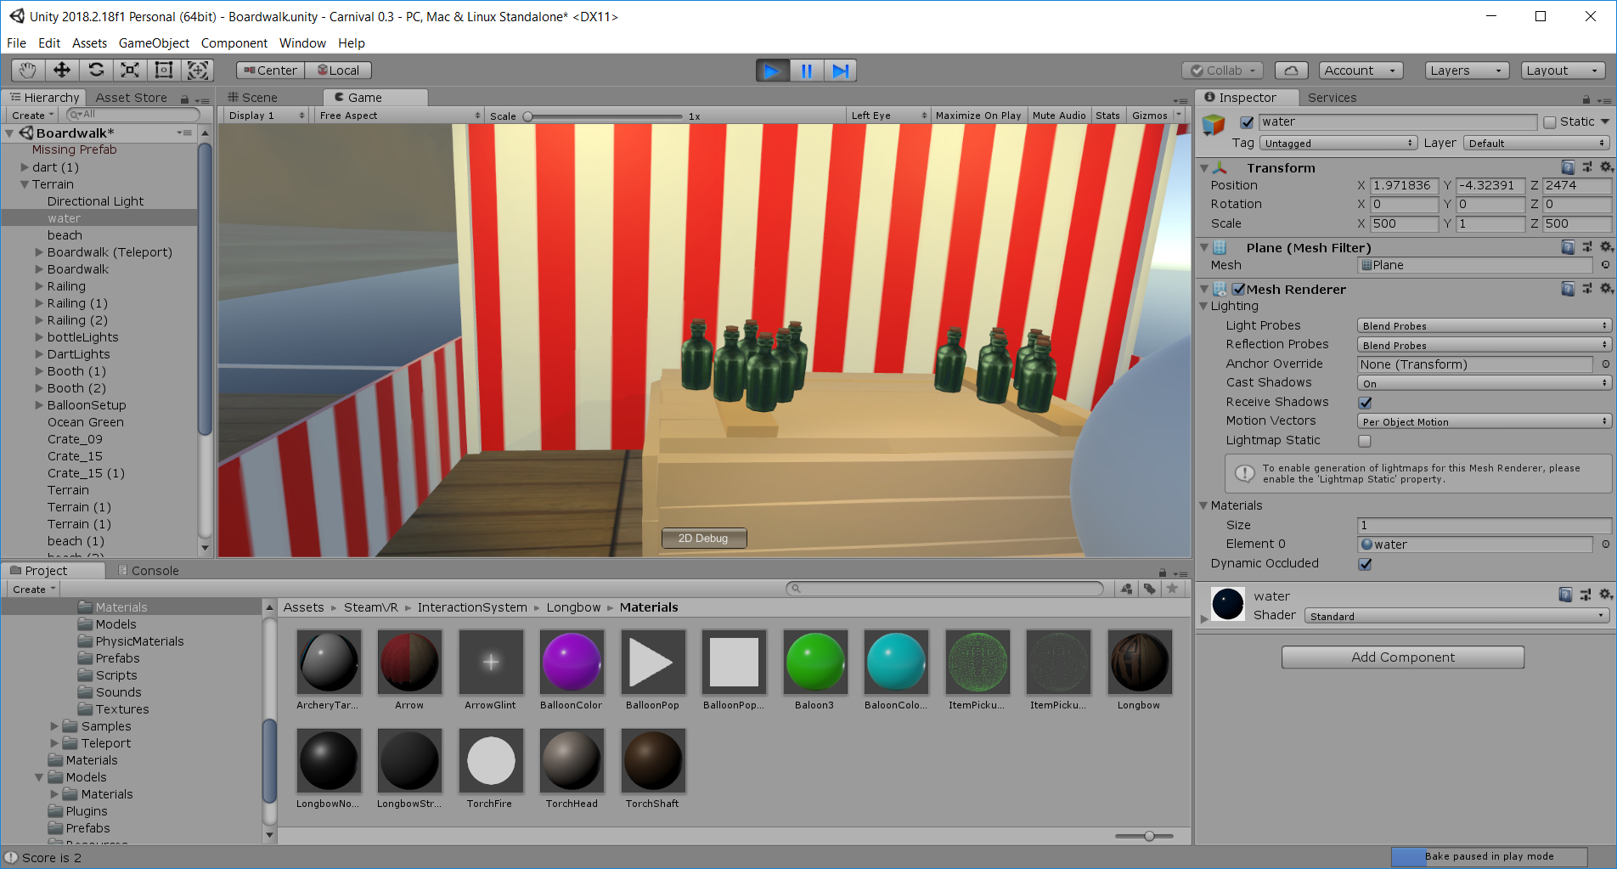
Bottle Toss

Slide 7
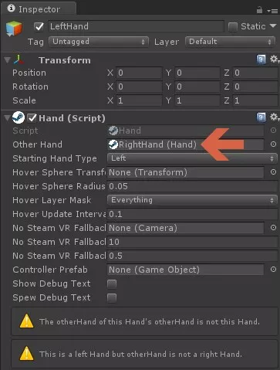
Problems we had
Controller tracking
Picking up items
Teleporting makes the floor invisible
The crate was a slingshot
The water was a solid object
The golf club will not transfer momentum
Circular linked list.

Slide 8
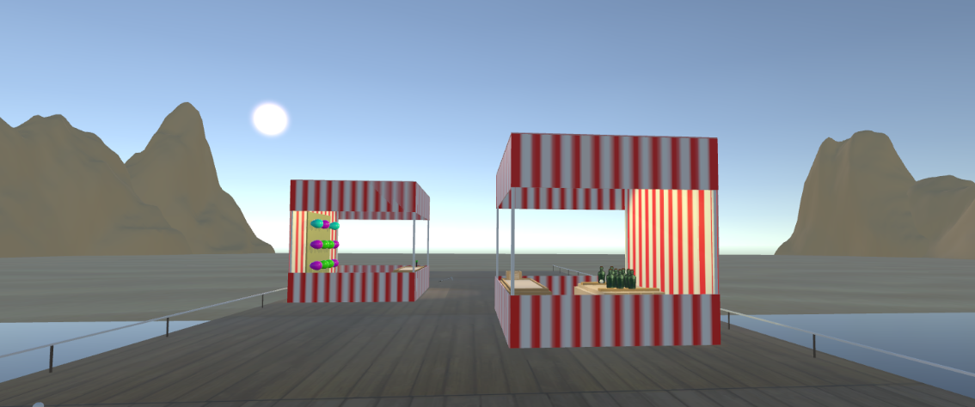
Things that needed extra detail
Hiding mountains
Carnival at 10AM?
Sound
Lighting
Scale in vr
Nothing has color to start
Balloons don't sound like fireworks

Slide 9




Tools we used

Slide 10
Stretch goals
Make golf more golfy
Create a city off in the distance
Underwater mini game
Throw animals
Pick up the spawn bucket
people

Slide 11
Thank you beta testers!

